Slide 1
CUPID & PSYCHE
W D Griffin, Jr
August 7, 2014

Slide 2
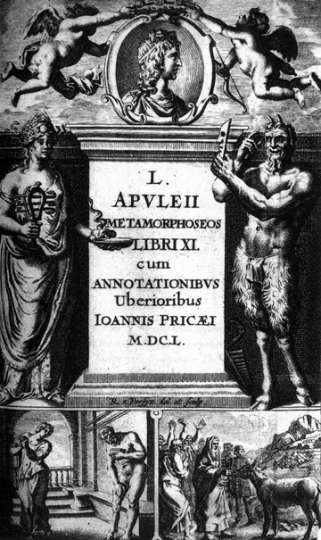
The only reference to the myth of Cupid and Psyche comes from L. Apuleius in the second century A.D.
It comes from the Metamorphoses, referred to by St. Augustine as Asinus aureus (The Golden Ass)
This is the only Roman novel to survive in Latin in its entirety
The myth itself covers approximately 20% of the eleven books of the novel beginning in Book 4 and finishing in Book 6
It is told by an elderly woman charged with tending to Lucius who has transformed himself into ass and Charite, both who have been taken by pirates, to soothe Charite’s fears

Slide 3
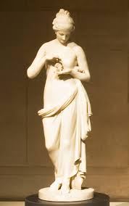
The Myth
There was an unnamed king of an unnamed country who had three daughters, one was very beautiful and admired by all
This daughter was named Psyche whose name means “soul”
The admiration for Psyche caused the altars of the temples of Venus to fall into disarray and smell of cold ashes
This adulation infuriated Venus to the point that she sent her son Cupid to make Psyche fall in love with the most vile and base of mankind
Upon seeing Psyche it was as if he had pricked himself with one of his own arrows: Cupid fell in love with her

Slide 4
Psyche’s two sisters married but due to the admiration of her beauty she remained unmarried
Concerned that his daughter’s inability to find a husband was the result of angering a god, her father consulted Apollo
Apollo’s answer was terrifying: Psyche must be dressed as a corpse and placed upon a mountain top where she would be wed to a serpent to be feared by all the gods, even Jupiter
The oracle was obeyed and Psyche was given the rites of a funeral for a living bride and placed on the mountain top
She resigned herself to her fate, realizing that it was Venus who was sending her to her impending death

Slide 5
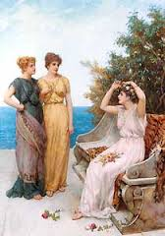
Once upon the mountain, Psyche is greeted by Zephyr and bourn by him to a lovely meadow where she promptly falls into a deep sleep
When she awoke, she saw a great palace; and, upon entering, voices told her that her every need would be fulfilled
Food, wine, baths all were provided
When she retired for bed, her anonymous bridegroom would enter the palace and leave before dawn
Meanwhile her sisters had set out to find her, but her bridegroom continually warned her not contact them if they approached her

Slide 6
Her bridegroom finally consented on the condition that she not reveal anything about him
The sisters arrived and Psyche kept the secret only telling them that her husband was a handsome young man
Psyche sent them away with riches but they were not satisfied
They agreed not to tell anyone that she was still alive and maintain the façade of her disappearance
The mysterious bridegroom warned her of the treachery and jealousy of her sisters; and that they would try to convince her to gaze upon his face which she must not do
If she did so, she would never see him again
He also told her that she was pregnant and that if she kept the secret the child would be divine

Slide 7
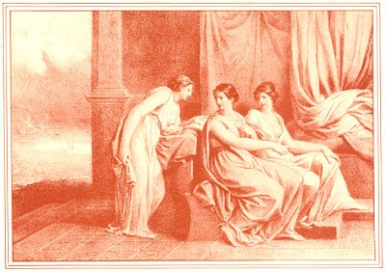
He granted her request to see her sisters a second time
On this visit she told her sisters that she was pregnant but that her husband was a middle-aged merchant
Again she sent them off with riches but the sisters suspected that her husband was a god and that her child would be divine
The sisters visited a third time but told Psyche that her husband was the serpent of the oracle and would devour her at the end of her pregnancy
Her sisters’ treachery put horror and fear into her causing her to forget the warning of her bridegroom

Slide 8
She devised a plan to hide a knife and burning lamp and, when the serpent was asleep, slash its throat
The sisters agreed to hide nearby to help her escape but they fled
Once her bridegroom was asleep, she retrieved the burning lamp and with knife in hand raised the lamp over the face of the bridegroom
When the light shone on his face, she saw not a monstrous serpent, but the beautiful face of Cupid
She gazed upon his wings and caressed his quiver of arrows and bow which lay at the foot of the bed, even pricking her thumb on one of the arrows, drawing blood

Slide 9
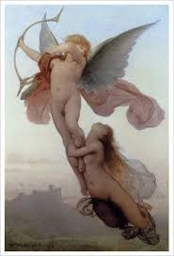
Overcome by desire, she kissed him passionately but as she did so hot oil from the lamp dropped on Cupid’s right shoulder causing a severe burn
Cupid leaped from the bed and attempted to fly away but Psyche grabbed his leg and held on until her strength failed and she fell to earth
Cupid admonished her from a cypress tree: he had disobeyed Venus and taken her as his love, and he had warned her not to gaze upon him; his flight would be her penalty
Cupid also vowed that her sisters would be “taken care of” for their roles in the betrayal

Slide 10
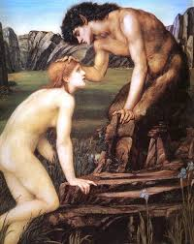
Psyche attempted to kill herself by throwing herself into a nearby river
The river had pity on her and carried her to Pan who advised her to try to win Cupid back
Psyche then made her way to the house of one of the sisters and told her what happened
She then told the sister that Cupid would marry her if she rushed to his side
The sister ran to the mountain and jumping invoked Zephyr to carry her to Cupid but Zephyr never came and she was killed on the rocks below
The other sister suffered the same fate

Slide 11
While Cupid lay in his mother’s bedroom nursing his wound, a sea gull told Venus what had happened
She immediately rushed to his side and berated him for his behavior
After leaving in a rage, Venus encountered Ceres and Juno who tried to console her and defend the actions of Cupid’s desire
Psyche then encountered Ceres and Juno who had pity on her but could befriend her fearing the anger of Venus
Venus abandoned her search on earth for Psyche and appealed to Jupiter for aid who sent Mercury to make a public announcement for the capture of Psyche
When Psyche was before her,Venus denounced her and physically abused her

Slide 12
Next Venus imposed a series of seemingly impossible trials for Psyche to complete
For her first trial Psyche was led to a granary with different types of grains mixed together which included wheat, barley, poppy seeds, chickpeas, lentils, and beans
Venus ordered that the grains be separated by nightfall
An ant and his army came to her rescue and sorted all the grains into separate piles
Venus was convinced that Cupid was responsible and she devised a second task for the next day
Venus next ordered Psyche to go a river bank where dangerous sheep with golden fleeces were known to take food and water

Slide 13
When Psyche arrived at the river, a reed whispered to her to wait until the sheep had left and gather the wool that clung to the trees under which the sheep would take shade from the blazing sun
She did as instructed and accomplished the task
Next Venus instructed her to go to the mountain where the Cocytus had its source and fill a jar with the cold dark water
The mouth of the river was guarded by a large dragon
The eagle of Jupiter swooped down and filled the jar with the water of the river
This was the same eagle that had swooped up Ganymede for Jupiter through Cupid’s agency and now the debt was repaid

Slide 14
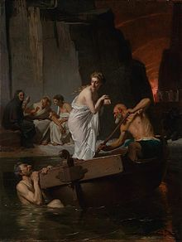
Venus was now angrier than ever that Psyche had completed all tasks successfully and devised one more task for her
Psyche was to take a box to the Underworld and obtain from Proserpina a piece of her own beauty and bring it back to Venus
In despair Psyche climbed a high tower with the intention of throwing herself off the tower
But the tower intervened and told her to enter the Underworld at Taenarus
It also told her that she would need sops (cakes) to get past Cerberus and two obuls to pay Charon to ferry her across the Styx
One thing that she must not do is to look inside the box

Slide 15
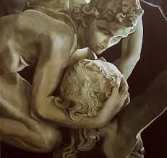
Psyche followed all the instructions except one
Feeling that the tasks had taken some of her beauty, Psyche opened the box only to find that it was not beauty but the deep sleep of the Underworld
Cupid, healed of his burn, found Psyche in the deep sleep and removed it from her and put it back into the box
He awakened Psyche and admonished her for allowing her curiosity to get the better of her a second time
He then bade her complete the task for Venus

Slide 16
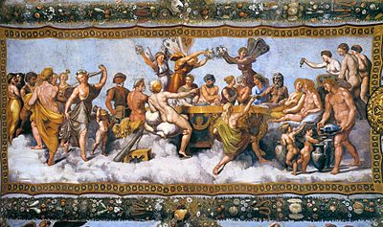
Cupid then appealed to Jupiter to ratify his marriage to Psyche
Jupiter consented and sent Mercury to return her to Olympus to be made immortal
The marriage appeased Venus hoping that Cupid would be more faithful
Upon her arrival in Olympus Psyche was given ambrosia to achieve her immortality
Cupid and Psyche had one daughter, Voluptas

Slide 17
REFERENCES
Gayley, Charles Mills. The Classical Myths in English Literature and in Art. New York: Blaisdell Publishing Company, 1963.
Hamilton, Edith. Mythology. New York: Grand Central Publishing, 2011.
Morford, Mark P. O. Classical Mythology. New York: Longman, Inc., 1977.
Ovid. Metamorphoses. New York: Signet Classics, 2009.
Tripp, Edward. The Meridian Handbook of Classical Mythology. New York: Penguin Books, 1974.
www.wikipedia.org/greek mythology. 2014.

