Slide 1
Roman Kings
and the founding of Rome

Slide 2
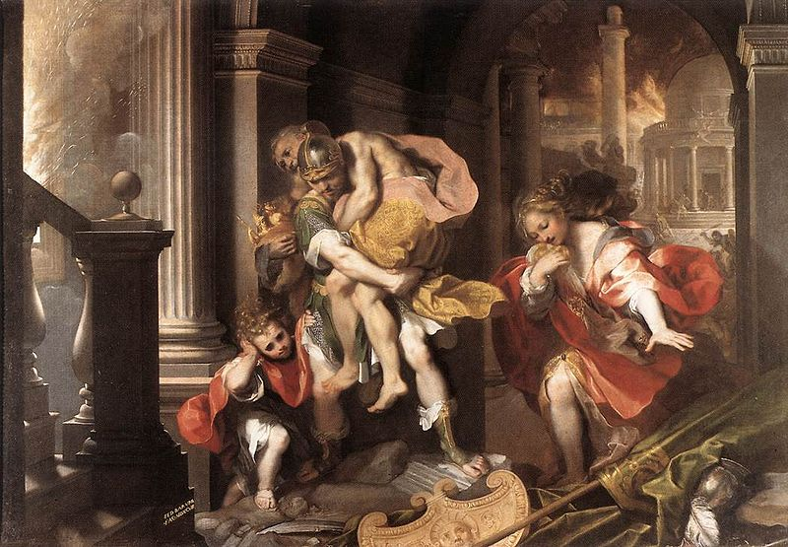
The Aeneid
Aeneas escaped from burning Troy with his father, Anchises, on his back and his son, Ascanius in tow.

Slide 3
Family Tree
Son of Anchisis and Venus (Aphrodite)
Son w/ Creusa @ Troy- Ascanius, also called Iulus (or Julius). Grows up to found Alba Longa
Son w/ Lavinia – Silvius, named for being born in the woods after Aeneas’ death. Succeeds Ascanius as king.

Slide 4
Fighting for Lavinia
Lavinia, daughter of Latinus (king of the Latins), is promised to Turnus before Aeneas shows up in Italy
Aeneas ultimately kills Turnus after a great chase, having seen Turnus wearing slain Pallas’ belt

Slide 5
Founding of Rome
Kings’ lineage
Romulus and Remus
Rhea Silvia
Mars (Ares)
Numitor- father of Rhea Silvia, reinstated after evil brother Amulius is killed by R&R

Slide 6
Romulus
Kills Remus
Kidnaps Sabine women, who develop Stockholm and convince king Titus Tatius to team up
Tarpeia betrays Rome to the Sabines
Lasted 5 years; Titus killed by inhabitants of Lavinium

Slide 7
Numa Pompilius
Sabine
Skipped 1 year after Romulus’ death; elected by Senate
Most religious and political institutions attributed to him

Slide 8
Tullus Hostilius
Warrior king
Defeated Alba Longa
Horatii- Male triplets from Rome
Curiatii- Male tripletes from Alba Longa
3 C wounded, 2 H killed; Publius tried to flee, was pursued, killed the 3 C. Sister QQ
Spoils of Curiatii – Pila Horatia

Slide 9
Ancus Marcius
Elected by the people
Reinforced Numa’s religious rites
Builder
Waged war against the Latins, who were on the Aventine hill
Founded port of Ostia
Built Mamertime prison

Slide 10
Lucius Tarquinius Priscus
Also Tarquin the Elder, Tarquin I
Etruscan Lucius means king
Legend: Upon arrival in Rome in a chariot, eagle took his cap and brought it back
Convinced Comitia Curiata to elect him over Marcius’ sons
Waged war against the Latins

