Slide 1
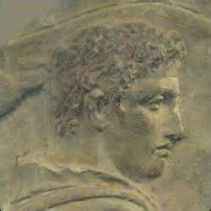
THESEUS
W. D. GRIFFIN, JR.
JANUARY 19, 2014

Slide 2
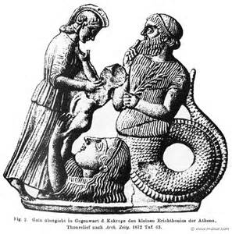
HOUSE OF CECROPS
Cecrops was half man and half snake who came to Attica from Crete or Egypt
called the land Cecropia
chose Athena rather than Poseidon as the protector
succeeded by Erichthonius, a.k.a. Erechtheus, who was also half serpent and half man
sprang from the repelled seed of Hephaestus who had attempted to rape Athena and had fallen to earth
Athena placed him in a chest and gave him to the daughters of Cecrops to be cared for

Slide 3
HOUSE OF CECROPS
two of the daughters could not resist: looked into the chest, were driven mad, and threw themselves off the acropolis
Athena took him back and raised him herself
as king of Athens instituted the festival of the Panathenaea
the daughters of Cecrops were Aglauros (bright), Herse (dew) and Pandrosos (all-dew)
Herse loved by Hermes and is the mother of Cephalus, beloved by Eos (Aurora) and married to Procris, daughter of Erechtheus and Praxithea (sisters are Creusa and Orithyia)
Aurora tempts Cephalus to test the faithfulness of Procris (Ovid, Metamorphoses)

Slide 4
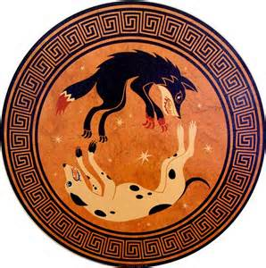
HOUSE OF CECROPS
Cephalus tests her faithfulness disguised as a stranger and as she is about to yield reveals himself
Procris leaves to follow Diana but is eventually reconciled with Cephalus
Diana gives her a javelin that cannot miss its mark and a hound that always catches its prey
The hound’s name was Laelaps and was turned to stone while chasing the Teumessian fox (also turned to stone) by Zeus since the fox could never be caught
Zeus placed them both in the heavens as the constellations Canis Major (Laelaps) and Canis Minor (Teumessian fox)

Slide 5
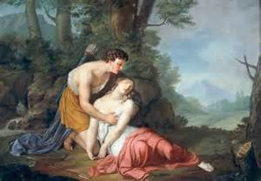
HOUSE OF CECROPS
Cephalus was accustomed to calling on Aura, goddess of the breeze to help him relax after hunting
Procris is told that Cephalus is calling to his lover in his sleep
Procris hides in the bushes near his resting spot
Cephalus calls upon Aura
Procris realizes that he is calling on the breeze and moves from her hiding spot
Cephalus thinking that he is about to be attacked by a wild animal hurls the javelin
Procris dies in his arms

Slide 6
HOUSE OF CECROPS
Erechthonius is succeeded by Pandion I
Pandion is more famous for his daughters Procne and Philomela (quick review)
Procne given to Tereus who had helped Pandion in war against Thebes
Procne bore him a son Itys
Philomela comes to visit and is raped by Tereus and imprisoned in a tower with her tongue cut out (couldn’t cry for help)
Procne finds out and releases Philomela and they cut up Itys, cook him and serve him to Tereus
Tereus chases them: Procne is turned into a nightingale who mourns for her son; Philomela into a swallow who tries to tell her story; and Tereus into a sea hawk

Slide 7
HOUSE OF CECROPS
Erechtheus succeeded Pandion and waged war on the people of Eleusis
Eumolpus, Thracian son of Poseidon, aided the people of Eleusis
Erechtheus sacrificed one of his daughters upon the advice of an oracle to secure the death of Eumolpus and victory
Poseidon had Zeus strike Erechtheus with his thunderbolt
Orithyia, sister of Procris, loved by Boreas who carried to Thrace as she was playing by the river Ilissus
mother of Zetes and Calais who chased the Harpies from Phineus and Cleopatra (married to Phineus) and Chione, mother of Eumolpus

Slide 8
HOUSE OF CECROPS
Third daughter of Erechtheus was Creusa who was loved by Apollo and bore him a son Ion
Creusa exposed him out of fear but he was saved by Hermes at the request of Apollo and carried him to Delphi
Ion becomes the treasurer of the sanctuary
Creusa married Xuthus (reward for aiding Erechtheus in defeating the Chalcodontids of Euboea)
Having no children Xuthus consults the oracle at Delphi which tells him to greet as his own son the first person that he meets when he leaves the temple which is Ion
Creusa thinks he is a bastard son of Xuthus and attempts to kill him but is thwarted by Athena

Slide 9
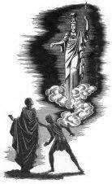
HOUSE OF CECROPS
Xuthus, Creusa and Ion return to Athens and Ion becomes the ancestor of the four Ionic tribes (main units of Athenian political structure)
Ion’s descendants colonized the islands and coast of Asia Minor later called Ionia
Erechtheus was succeeded by Pandion II who was driven out of Attica by his uncle Metion and fled to Megara
had four sons: Aegeus, Pallas, Nisus and Lycus
recovered the throne of Athens after Pandion’s death and shared the power but Aegeus was sovereign since he was the eldest
Ninus returned to Megara as its king

Slide 10
AEGEUS & AETHRA
As king of Athens, he was threatened by his brother Pallas
being childless he consulted the oracle at Delphi which told him “not to undo the wineskin’s mouth” until he had returned home
not knowing what the oracle meant he asked his host, Pittheus king of Troezen what it meant (he did)
Pittheus gave him his daughter Aethra to lie with
the next morning Aegeus told Aethra that, if she bore a son, she was to raise him without telling who his father was
some sources say that, after sleeping with Aegeus, Aethra waded into the ocean and slept with Poseidon, giving Theseus a mortal and immortal father (similar to Heracles)

Slide 11
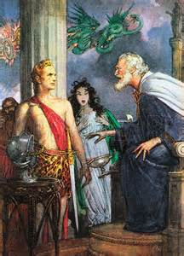
AEGEUS & AETHRA
then she was to send him to Athens when he was old enough to lift a rock under which he would leave a sword and sandals by which he would recognize his son
in time she bore him Theseus
Theseus lifted the rock and removed the sword and sandals when he was of age
Theseus refused to take the safe route to Athens by sea opting for the more dangerous land route in spite of the pleas of Aethra and Pittheus

Slide 12
THE ROAD TO ATHENS
Theseus followed the more dangerous path along the Saronic Gulf where he encounters six chthonic enemies guarding six entrances to the Underworld
Epidaurus: defeats Periphetes, a son of Hephaestus generally called Corynetes (club man), who beat opponents into the earth; Theseus beats him with his own club and keeps it in imitation of Heracles
Isthmus of Corinth: defeats the robber Sinis who was also called Pityocamptes (the Pine bender) which referred to the manner in which he killed his victims by bending two pine trees to the ground, tie each end of the victim to one of the two trees and then releasing the trees; Theseus disposed of him in this manner; he was the father of Melanippus by his daughter Perigune

Slide 13
THE ROAD TO ATHENS
Crommyon: Theseus kills the man-eating sow that was terrorizing the village of Crommyon said to have been bred by Phaea or the offspring of Typhon and Echidna (Bibliotheca)
Megara: the limestone cliffs along the path to Megara were guarded by Sciron who would ask travelers to wash his feet and then kick them off the cliffs into the sea to be eaten by a giant turtle; Theseus kicked him off the cliff; Sciron means limestone and had his own cult following in Megara, Salamis and other parts of Attica where there were limestone outcrops

Slide 14
THE ROAD TO ATHENS
Eleusis: here Cercyon would challenge travelers to a wrestling match and kill them when they lost; Theseus defeats him and kills him; some sources indicate that he was a “year king” and was required to do this and would relinquish the throne if he lost; Theseus abandoned this practice when he became king
The plains of Eleusis on the road to Athens: guarded by Procrustes (the Stretcher) who would offer travelers a bed for sleep; had two beds, one short and one long; he would make the traveler fit the bed either by stretching them to fit the long one or chopping off their legs to fit the short one; Theseus made him fit by cutting off his feet and head; a.k.a. Damastes (Subduer), Procoptes (Slicer) or Polypemon (Troubler)

Slide 15
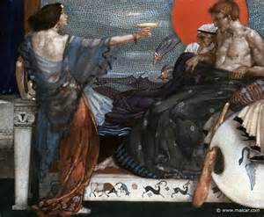
AEGEUS & MEDEA
Upon his return to Athens Aegeus married Medea who had fled from Jason
bore him a son Medus
Theseus is not recognized immediately by Aegeus but he is by Medea as a rival to Medus
She tells Aegeus that Theseus is a threat to his throne and suggests a banquet at which she will poison his wine
Aegeus recognizes the sword when Theseus uses it to carve his meat, knocks the wine from his hands and declares him his successor

Slide 16
AEGEUS & MEDEA
Medea and Medus flee Athens for the Middle East
Medus was not the only threat to the throne
Pallas and his sons plotted to overthrow Aegeus and to kill Theseus
the plan was to divide into two groups; one would force Theseus and Aegeus out of the palace while another would hide and ambush them as they fled the palace
Theseus is told of the plan by a herald, Leos, and leaves the palace the night before and slays the ambushers (Plutarch)
Pallas and the remaining Pallantides are no longer a threat

Slide 17
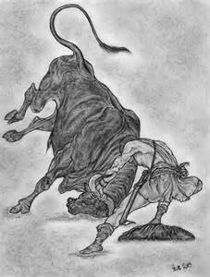
THE MARATHONIAN BULL
The Marathonian bull was brought to Attica by Heracles from Crete and terrorized Marathon
some sources say that Medea sent Theseus to capture the bull as a means of getting rid of him
Theseus mastered the bull and herded it back to Athens where he sacrificed it to Apollo Delphinius
some legends say that an old woman named Hecale provided him with food and shelter on his way to Marathon and offered to sacrifice to Zeus upon his safe return
she died before his return and Theseus ordered that she share the honors of Zeus Hecalus at an annual festival

Slide 18
THE HOUSE OF MINOS
Minos I was the son of Zeus and Europa and after his death served in Hades as a judge with his brother Rhadamanthus and King Aeacus
Hesiod and Homer describe him as the eminent law-giver
grandson Minos II bragged that he could obtain whatever he desired by praying to Poseidon
as a test he prayed that Poseidon send him a bull to sacrifice which Poseidon sent
the bull was so beautiful that Minos refused to sacrifice it (bad idea. Remember Odysseus?)

Slide 19
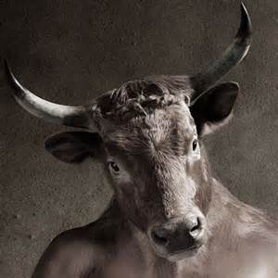
THE HOUSE OF MINOS
Poseidon drove the bull wild and made the wife of Minos, Pasiphaë, fall madly in love with the bull
Daedalus the famous artificer built a wooden cow whereby Pasiphaë could mate with the bull
the offspring of this union was the Minotaur, head of a bull and body of a man
the bull was captured by Heracles who rode it through the waves to Greece
meanwhile the Minotaur terrorized Crete until Daedalus built the Labyrinth in which to imprison the Minotaur where lived upon human victims

Slide 20
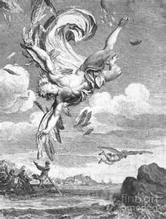
THE HOUSE OF MINOS
Daedalus is imprisoned by Minos to prevent him from spreading knowledge of the Labyrinth
with no other way to escape he fashioned wings out of wax for himself and his son Icarus
Daedalus warns Icarus not to fly to close to the sun but in his excitement he soars too high, the sun melting the wings, and Icarus falls to his death
Daedalus flies to Sicily where he is received by King Cocalus
Daedalus builds a temple to Apollo and hung the wings as an offering to Apollo

Slide 21
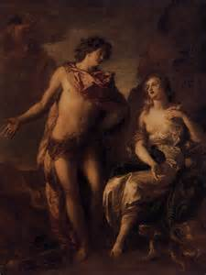
THE HOUSE OF MINOS
Minos followed Daedalus to Sicily with the intentions of killing him but the daughters of Cocalus scalded him to death while he was bathing before he could
his nephew Perdix was placed under his care to learn mechanical arts
while walking on the shore, Perdix found the spine of fish and invented the saw and later two compasses
Daedalus threw him off a tower out of jealousy and killed him
Athena changed him into a partridge

Slide 22
THE LABRYNITH
Androgeus, the son of Minos, came to Athens and incurred the anger of the Greeks by winning all the Panathenaic games
was killed out f jealousy either by ambush or was sent by Aegeus to capture the Marathonian bull which killed him
Minos attacks and defeats Megara after which Aegeus makes a treaty with Minos
terms stated that every 9 years, some sources say every Great Year (seven solar years), 7 young men and 7 maidens of noble families would be sent to Crete as a tribute to be shut up in the Labyrinth and devoured by the Minotaur

Slide 23
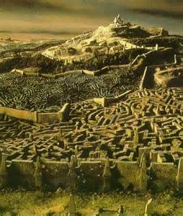
THE LABRYNITH
The victims were chosen by lot and Theseus volunteered to go with Minos
Hellanicus says that Minos chose the victims himself and picked Theseus
while at sea, Minos attempted to rape one of the maidens, Eriboea who called upon Theseus for help
Theseus intercedes and draws the wrath of Minos
Minos calls upon Zeus to prove that he is his son and Zeus sends a thunderbolt
Minos challenges Theseus to prove that he is the son of Poseidon and throws a ring into the sea for him to recover

Slide 24
THE LABRYNITH
Theseus recovers the ring and returns to the ship and sails to Crete
Ariadne falls in love with Theseus and gives him a ball of thread which had been a gift to her from Hephaestus
Theseus attaches the thread to the entrance gate and finds his way to the Minotaur and slays him in his sleep
Theseus uses the thread to escape the Labyrinth
Theseus takes the remaining youths and Ariadne and her sister Phaedra and sail for Athens
they stop at the island of Naxos (Dia) for rest where Athena tells Theseus to abandon Ariadne and sail for home

Slide 25
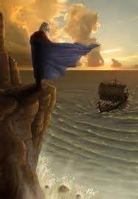
THE LABRYNITH
If Theseus was victorious, he was to change the sails from black to white
In his despair at leaving Ariadne behind he forgets to change the sails before sailing home
Aegeus sees the black sail and throws himself either off a cliff or from the temple of Poseidon into the sea
it is still called the Aegean Sea
the ship was preserved in the harbor of Athens and was used to pay tribute to Apollo every year at Delos
no executions were allowed during this time (several weeks)
rotting parts were replaced which leads to the Ship of Theseus Paradox

Slide 26
ARIADNE
Some sources state that Ariadne gives Theseus a wreath that lights the way to aid in his escape
Bacchylides says that Theseus brought the wreath with him, a gift from Amphitrite
Either way Ariadne wears the wreath on the flight from Crete until she is deserted by Theseus and found by Dionysus
Dionysus takes the wreath from her and sets in the heavens as the constellation Corona
Hesiod makes her the wife of Dionysus whom Zeus makes immortal (Theogony)
Homer states that she was killed by Artemis for eloping with Theseus while betrothed to Dionysus
one last version states that Theseus and Ariadne sailed to Cyprus where they are separated by a storm and she dies giving birth to his child

Slide 27
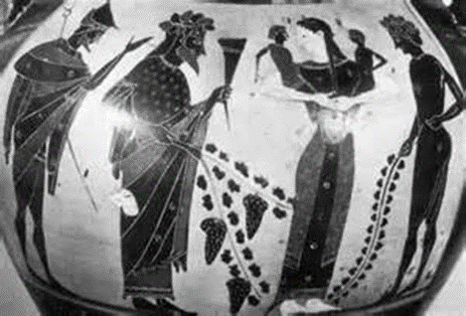
ATHENS (HOME AT LAST)
While on the journey to Athens, Plutarch states that Theseus sails to Delos where he and his companions dance the Crane Dance (geranos)
Theseus becomes king with the death of Aegeus
he reinstitutes the Isthmian Games (emulating Heracles’ founding of the Olympics)
Institutes synoecism, or the union of different villages surrounding Athens with Athens as the center
Organized the Athenian people into three classes: nobles, farmers and craftsmen

Slide 28
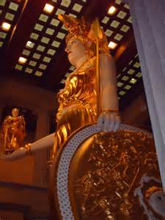
THE AMAZONS
Theseus joined Heracles in his expedition against the Amazons
received the Amazon queen Antiope as his part of the spoils (some sources say it was Hippolyta) who bore him Hippolytus
the Amazons return the favor and invade Attica but are defeated
scenes from the battle are depicted in the Hephaestaeum at Athens and the Stoa Poecile (Painted Colonnade); the metopes of the Parthenon; the shield of Athena Parthenos on the Acropolis; and the pedestal of the statue of Zeus at Olympus

Slide 29
PIRITHOÜS
King of the Lapiths and the son of Ixion (some say Zeus)
Gained the friendship of Theseus when he stole his cattle
When about to be caught, Pirithoüs turned and greeted Theseus who welcomed his bold behavior
was saved by Theseus during the Calydonian boar hunt
Theseus attended the wedding of Pirithoüs and Hippodamia
The Centaurs were also invited since they were related to the bride
The Centaur Eurytrion became drunk and attempted to abduct the females as well as the bride

Slide 30
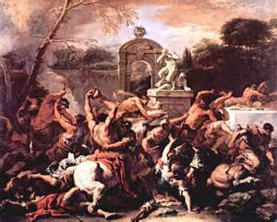
PIRITHOÜS
the battle that followed was called the Centauromachy
The Centaurs were defeated
Hippodamia bore a son Polypoetes but died soon after his birth
After the death of Hippodamia, Pirithoüs and Theseus decide to find new wives

Slide 31
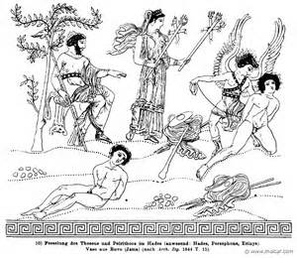
PIRITHOÜS
Theseus decides to abduct Helen, who was a young girl at the time
The abduction is successful and Helen is left with Aethra while Theseus and Pirithoüs go to the Underworld to abduct Persephone
They are seated on the Chairs of Forgetfulness
Theseus is rescued by Heracles but Pirithoüs cannot be moved
While in the Underworld, Castor and Pollux retrieve Helen and take Aethra and Physadeia, the sister of Pirithoüs, as handmaids who accompany Helen to Troy (Hyginus, Fabulae)

Slide 32
PHAEDRA
Theseus returned from the Underworld less part of his buttocks which stuck to the Chair of Forgetfulness (called “hypolispos” which means “hind parts rubbed smooth”
Theseus loses interest in Hippolyta when he sees Phaedra (name means bright) and marries her
They have two sons: Demophon and Acamas
When Phaedra sees Hippolytus who was a devout follower of Artemis, she becomes smitten with him and makes advances to him, while Theseus is away, which he rejects
Some sources say that Phaedra’s nurse tells Hippolytus of Phaedra’s feelings for him
Either way Phaedra hangs herself and leaves a note accusing him of making advances toward her

Slide 33
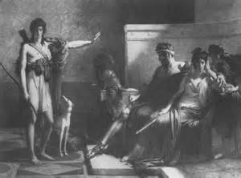
PHAEDRA
Theseus becomes enraged and banishes Hippolytus and calls on Poseidon to destroy him
Poseidon sends a bull from the sea which causes the horses to bolt throwing Hippolytus from the chariot, almost dragging him to death (supposedly the third wish granted by Poseidon to Theseus with the other two being to escape the Labyrinth and to escape from Hades)
His body is returned to the palace where he is reconciled with Theseus after Artemis intercedes and promises a cult following for him

Slide 34
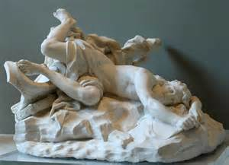
HIPPOLYTUS
Hippolytus was honored with a cult at Troezen in honor of Artemis in whose honor he avoided all women
He was honored in Athens with a cult associated with Aphrodite whose temple “Aphrodite by Hippolytus” was on the south side of the Acropolis
Asclepius was said to have raised him from the dead
He reappears in Latium as the god Virbius

Slide 35
THE DEATH OF THESEUS
After political unrest Theseus is driven from Athens by Menestheus who usurped the throne
Menestheus was the Athenian leader at Troy according to Homer
Theseus goes to the island of Scyros where he owned land
He is killed by Lycomedes in whose court that Achilles hid disguised as a girl
Demophon succeeded Menestheus after his death at Troy and returned Aethra to Athens
Demophon fell in love with a Thracian princess Phyllis and left her in Thrace promising to return
When he did not return soon enough, she hung herself and was turned into an almond tree

Slide 36
THE DEATH OF THESEUS
The last king was Cordus who sacrificed himself to save Athens when the Peloponnesians invaded Athens
The Delphic oracle prophesied that the side whose king was killed would win
Cordus disguised himself as a peasant and crept into the Peloponnese camp and was killed giving Athens victory
Theseus’ bones were returned to Athens by Cimon after the Persian War when the Greek allies conquered Scyros
The return of the bones gave Athens claim to lead the Ionian Greeks
finis

Slide 37
REFERENCES
Gayley, Charles Mills. The Classical Myths in English Literature and in Art. New York: Blaisdell Publishing Company, 1963.
Hamilton, Edith. Mythology. New York: Grand Central Publishing, 2011.
Morford, Mark P. O. Classical Mythology. New York: Longman, Inc., 1977.
Ovid. Metamorphoses. New York: Signet Classics, 2009.
Tripp, Edward. The Meridian Handbook of Classical Mythology. New York: Penguin Books, 1974.
www.wikipedia.org/greek mythology. 2014.

